Slide 1

Concurrency Control Techniques: 2PL, Strict 2PL, and Timestamp Ordering
Database Management System | Transaction Management and Scheduling
Course: Database Management System (DBMS) | Chapter: Transaction Management and Scheduling | Program: B.TECH-CSE, B.TECH CSE - CYBER SECURITY, B.TECH CSE - DATA
DISCOVER · LEARN · EMPOWER
Notes:
Welcome everyone to today's lecture on Concurrency Control. We are diving deep into the mechanisms that ensure data integrity when multiple transactions run simultaneously. Our focus today is strictly on Two-Phase Locking, Strict 2PL, and Timestamp Ordering. These are the pillars of reliable transaction scheduling in modern database systems.

Slide 2
Course Outcomes
SLIDE 2 / 14
Course Outcome
CO | BT LEVEL | DESCRIPTION
CO1 | BT2 | Explain database architecture, relational model concepts and formal query language foundations including relational algebra and relational calculus.
CO2 | BT3 | Apply relational algebra, relational calculus and SQL constructs to formulate correct and efficient database queries.
CO3 | BT4 | Analyze functional dependencies and design normalized relational schemas up to 5NF ensuring lossless join and dependency preservation.
CO4 | BT4 | Analyze transaction schedules and concurrency control mechanisms to determine serializability, recoverability and correctness.
CO5 | BT5 | Evaluate storage structures, indexing strategies and query optimization techniques for performance, scalability and reliability.
Chandigarh University
2 / 14
Notes:
Today's session directly addresses our Course Outcomes. CO3 ensures you understand schema design, but CO4 is our primary focus here. We will analyze how specific concurrency control mechanisms determine if a schedule is serializable and correct. This analysis is crucial for building robust database applications.

Slide 3
Learning Objectives
SLIDE 3 / 14
Learning Outcomes
1
Analyze the fundamental principles of Two-Phase Locking (2PL) protocols.
2
Evaluate the differences between basic 2PL and Strict 2PL mechanisms.
3
Apply the Timestamp Ordering protocol to resolve conflicting transaction requests.
4
Determine the serializability and recoverability of various transaction schedules.
5
Identify common pitfalls like deadlocks and cascading rollbacks in concurrency.
Chandigarh University
3 / 14
Notes:
By the end of this lecture, you will be able to analyze how 2PL prevents conflicts. You will evaluate why Strict 2PL is often preferred over basic 2PL for recoverability. We will also apply timestamp ordering to resolve conflicts without locks. Finally, you will identify common pitfalls like deadlocks that can stall your system.

Slide 4
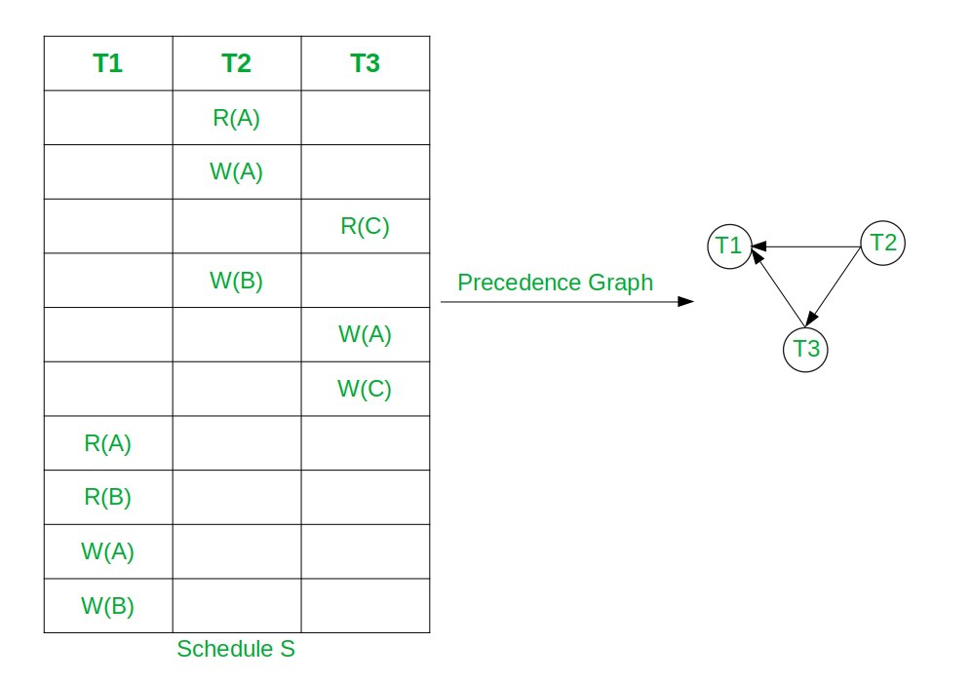
Lecture
SLIDE 4 / 14
Concurrency Control and Serializability
1
Concurrency control ensures database consistency when multiple transactions execute simultaneously.
2
A schedule is serializable if its outcome is equivalent to some serial execution.
3
Conflict serializability checks if swapping non-conflicting operations preserves the result.
4
Recoverability ensures no transaction commits data that might later be rolled back.
5
Without control, lost updates and dirty reads can corrupt the database state.
6
The goal is to allow parallelism while maintaining ACID properties strictly.
Equivalent Serial Schedule of Conflict Serializable Schedule in DBMS - GeeksforGeeks
Chandigarh University
4 / 14
Notes:
Concurrency control is essential to maintain consistency when transactions overlap. We aim for conflict serializability, meaning the concurrent schedule looks like a serial one. If a transaction reads uncommitted data, we risk a dirty read. Our techniques must prevent this while maximizing parallelism for performance.

Slide 5
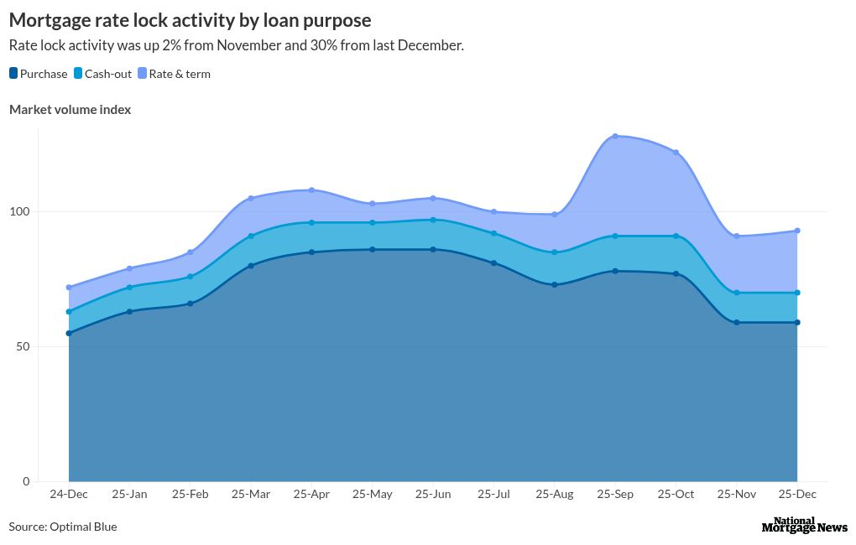
Lecture
SLIDE 5 / 14
Two-Phase Locking (2PL) Protocol
GROWING PHASE
Transaction acquires all necessary locks before releasing any.
SHRINKING PHASE
Transaction releases locks but cannot acquire new ones.
• 2PL divides transaction execution into a growing phase and a shrinking phase.
• Once a lock is released, no new locks can be requested by the transaction.
• 2PL guarantees conflict serializability for all schedules generated by the protocol.
• The protocol prevents cascading rollbacks if combined with strict locking rules.
Source: public.flourish.studio
Chandigarh University
5 / 14
Notes:
Think of 2PL as having two distinct phases for every transaction. First, you gather all your keys (locks) before you start using them. Once you drop a key, you cannot pick up another one. This strict rule guarantees that the resulting schedule is conflict serializable, which is a huge win for correctness.

Slide 6
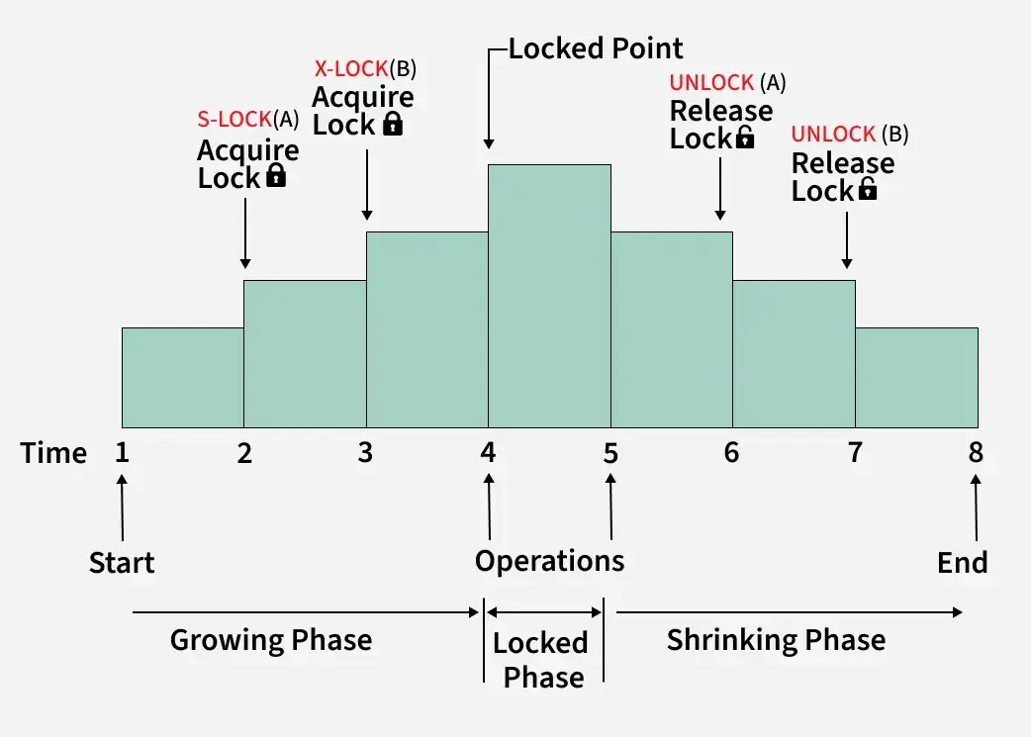
Lecture
SLIDE 6 / 14
Strict Two-Phase Locking (Strict 2PL)
1
Strict 2PL holds all exclusive locks until the transaction commits or aborts.
2
Shared locks can be released early, but exclusive locks are held to the end.
3
This prevents cascading rollbacks because no transaction reads uncommitted data.
4
If a transaction fails, its locks are released, forcing others to wait.
5
Strict 2PL is the most common implementation in commercial database systems.
6
It trades some concurrency for guaranteed recoverability and simplicity.
Source: media.geeksforgeeks.org
Chandigarh University
6 / 14
Notes:
In Strict 2PL, we hold onto exclusive locks until the very end. This means if Transaction A is modifying a row, Transaction B cannot read it until A commits. This eliminates cascading rollbacks entirely. While it reduces concurrency slightly, it makes recovery much simpler and safer.

Slide 7
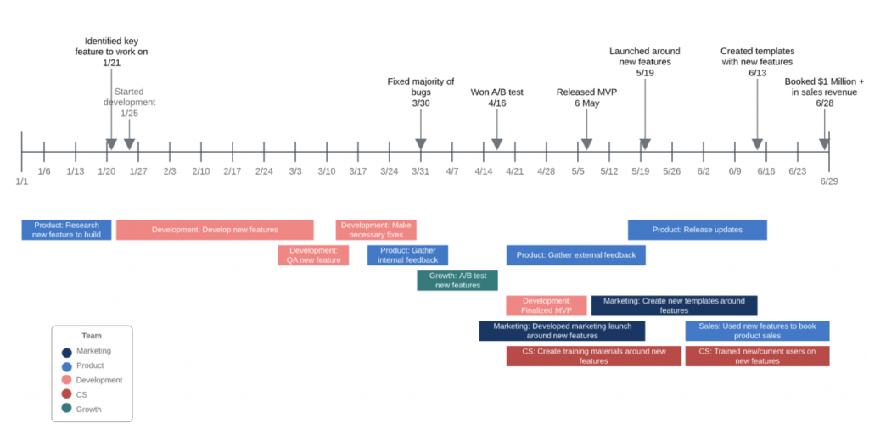
Worked Example
SLIDE 7 / 14
Strict 2PL Schedule
SCHEDULE
R1(X), R2(X), W1(X), Commit1, W2(X), Commit2.
• T1 reads X (Shared Lock), T2 reads X (Shared Lock), T1 writes X.
• T2 must wait for T1 to release its exclusive lock before writing X.
• T1 commits, releasing all locks, allowing T2 to proceed with its write.
• This schedule is conflict serializable and strictly recoverable.
• T2 never reads uncommitted data from T1, ensuring data integrity.
Source: cdnb.ganttpro.com
Chandigarh University
7 / 14
Notes:
Let's look at a concrete example. T1 and T2 both read X. T1 wants to write X, so it gets an exclusive lock. T2 must wait. T1 commits, releasing the lock. Now T2 can write. Notice T2 never read T1's uncommitted data. This is a clean, recoverable schedule.

Slide 8
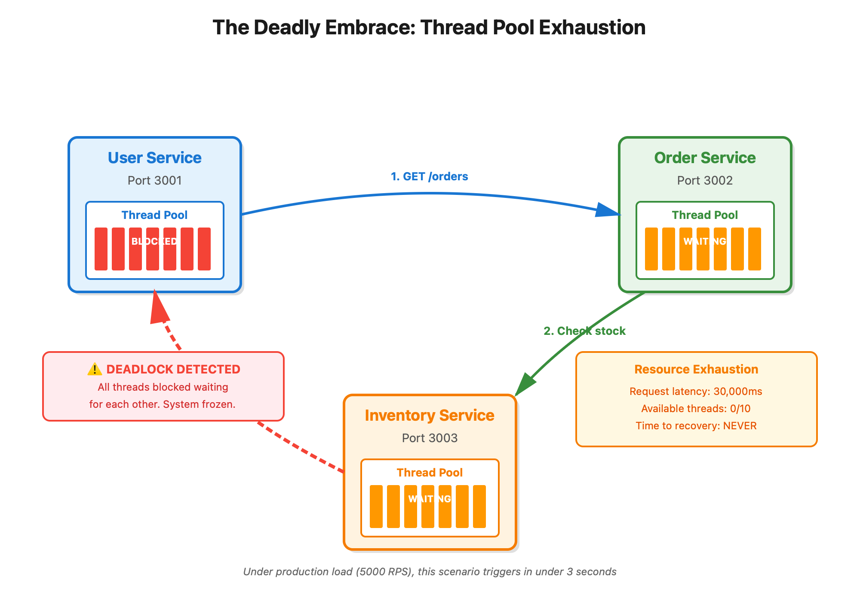
Pitfalls
SLIDE 8 / 14
Deadlocks in Locking Protocols
EXAMPLE
T1 holds Lock A, waits for Lock B; T2 holds Lock B, waits for Lock A.
• Deadlock occurs when two transactions wait for each other to release locks.
• The system enters a state where no progress can be made without intervention.
• Detection methods include wait-for graphs and timeout mechanisms.
• Resolution involves aborting one transaction to break the circular wait.
• Prevention strategies include ordering lock acquisition or using timestamp ordering.
Source: substackcdn.com
Chandigarh University
8 / 14
Notes:
A major pitfall of locking is the deadlock. Imagine T1 holds resource A and wants B, while T2 holds B and wants A. They are stuck forever. We detect this using wait-for graphs. The solution is usually to abort one transaction, sacrificing it to save the system.

Slide 9
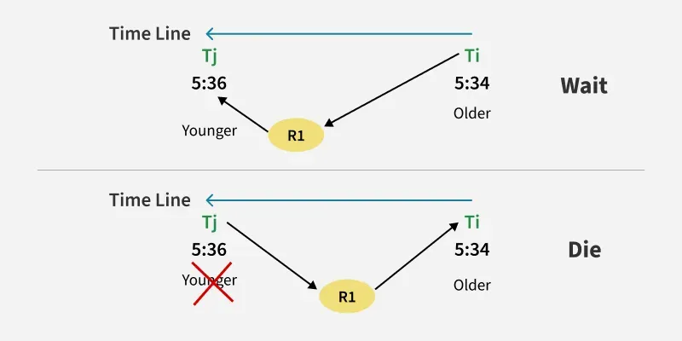
Lecture
SLIDE 9 / 14
Timestamp Ordering Protocol Overview
1
Each transaction is assigned a unique timestamp upon entry to the system.
2
Read and Write operations are validated against existing timestamps of data items.
3
If a transaction is older, it proceeds; if newer, it may be rolled back.
4
This protocol ensures serializability without using locks or waiting.
5
It is a non-blocking approach that avoids deadlocks entirely.
6
Transactions are executed in the order of their assigned timestamps.
Source: media.geeksforgeeks.org
Chandigarh University
9 / 14
Notes:
Now let's switch to Timestamp Ordering. Here, every transaction gets a unique ID, like a birth time. We execute them in that order. If a transaction tries to write data that a newer transaction has already read, we have a conflict. We simply abort the older transaction and restart it.

Slide 10
Timestamp Ordering
SLIDE 10 / 14
Read and Write Rules
READ RULE
If TS(T) < Read_TS(X), abort T and restart.
WRITE RULE
If TS(T) < Read_TS(X) or TS(T) < Write_TS(X), abort T.
• If valid, update Write_TS(X) to max(Write_TS(X), TS(T)).
• These rules ensure that older transactions appear to execute first.
• A transaction is only allowed to proceed if it does not violate order.
• The protocol maintains a consistent global order of execution.
Chandigarh University
10 / 14
Notes:
The rules are strict. If T1 wants to read X, but a newer T2 has already read X, T1 must abort. Similarly for writes. If T1 tries to write X, but T2 has already read it, T1 is too late. We abort T1 and restart it with a new timestamp. This keeps the order consistent.

Slide 11
Worked Example
SLIDE 11 / 14
Timestamp Ordering
GOVERNING EQUATION
T1 (TS=10) writes X, T2 (TS=20) reads X, T3 (TS=30) writes X
1
T1 writes X: Write_TS(X) becomes 10. Success.
2
T2 reads X: TS(20) > Read_TS(X)=10. Success. Read_TS(X) becomes 20.
3
T3 writes X: TS(30) > Read_TS(X)=20. Success. Write_TS(X) becomes 30.
4
Schedule is serializable as T1 -> T2 -> T3.
5
No deadlocks occurred as no transaction waited for another.
Chandigarh University
11 / 14
Notes:
Let's trace this. T1 writes X at time 10. T2 reads X at time 20. Since 20 is greater than 10, T2 is allowed to read. T3 writes at 30. Since 30 is greater than the read time 20, T3 is allowed. The order is preserved perfectly without any waiting.

Slide 12
Comparison
SLIDE 12 / 14
Locking vs. Timestamp Ordering
1
Locking (2PL) allows waiting but risks deadlocks and starvation.
2
Timestamp Ordering avoids deadlocks but causes frequent transaction aborts.
3
Locking is better for high contention on hot data items.
4
Timestamp Ordering is better for low contention and read-heavy workloads.
5
Strict 2PL ensures recoverability; Timestamp Ordering requires restart logic.
6
Choice depends on the specific workload and database access patterns.
Chandigarh University
12 / 14
Notes:
So, which is better? Locking allows waiting but risks deadlocks. Timestamp ordering avoids deadlocks but forces restarts. If you have hot data with high contention, locking might be better. For read-heavy workloads with low contention, timestamp ordering shines. The choice depends on your specific workload.

Slide 13
Lecture
SLIDE 13 / 14
Key Takeaways
1
Two-Phase Locking guarantees serializability by separating lock acquisition and release.
2
Strict 2PL prevents cascading rollbacks by holding exclusive locks until commit.
3
Timestamp Ordering ensures serializability without locks by enforcing a global order.
4
Deadlocks are a risk in locking protocols but are avoided in timestamp ordering.
5
Both techniques are essential for maintaining ACID properties in concurrent systems.
Chandigarh University
13 / 14
Notes:
To summarize, 2PL guarantees serializability through strict phases. Strict 2PL adds recoverability by holding locks until the end. Timestamp ordering offers a lock-free alternative that avoids deadlocks. Both are vital for ensuring your database remains consistent and reliable under load.

Slide 14
Lecture
SLIDE 14 / 14
References
1
Fundamentals of Database Systems — Ramez Elmasri & Shamkant B. Navathe
2
Database System Concepts — Silberschatz, Korth & Sudarshan
3
Database Management Systems — Raghu Ramakrishnan & Johannes Gehrke
4
Oracle/MySQL Documentation — Oracle
Chandigarh University
14 / 14
Notes:
For further reading, please refer to the standard texts by Elmasri, Silberschatz, and Ramakrishnan. These books provide deep dives into the theory and implementation of these protocols. The Oracle documentation is also excellent for practical implementation details. Thank you for your attention.

